Slide 1
301 Oct 1, Class 7
Chapter 6, Statistics
  Descriptive statistics
  Inferential statistics
  Data visualization

Slide 2
Statistics theory refresher
We work with samples of data
  From the broader population
Descriptive statistics: mean (average), variance
  SD, SE
Effect: Difference in the DV due to the IV
Null hypothesis: the observed difference occurred simply due to random variance in performance
  The p-value is this probability
  <.05 means it is improbable, we can “reject the null”

Slide 3
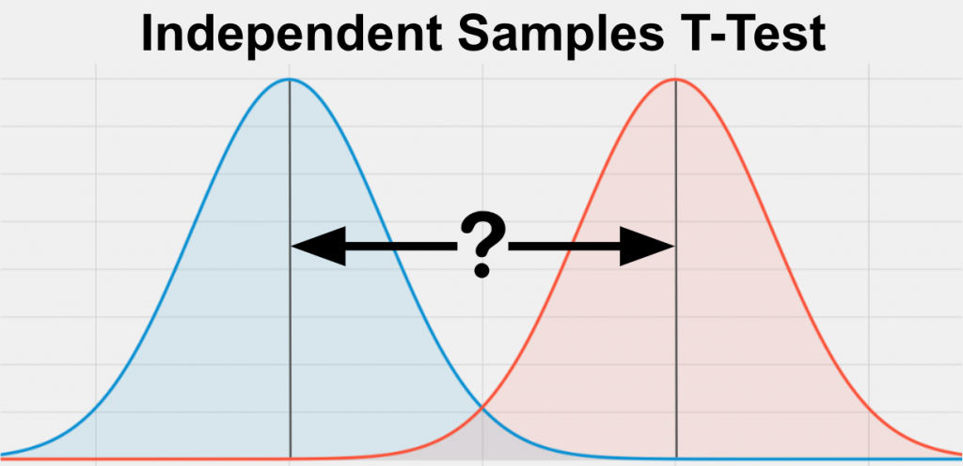
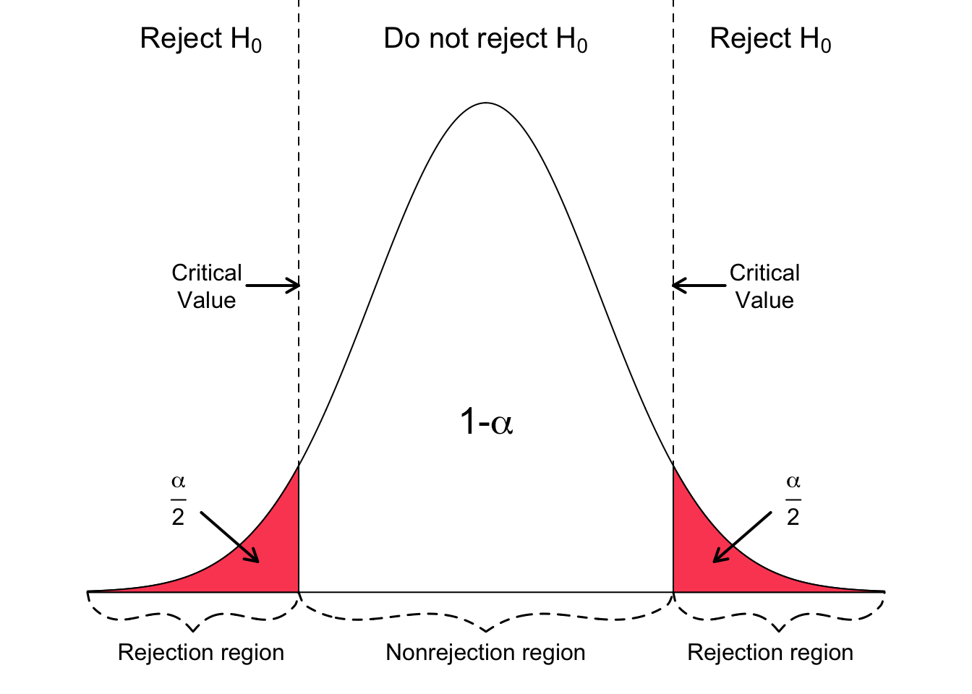
Theory: t-test
t = mean difference / variance
Data distributions for two conditions

Slide 4
Homework questions
A psychologist wants to compare the average test anxiety scores of students who receive mindfulness training and those who do not. Which t-test should be used and why?
Participants rate their mood before and after a 10-minute guided meditation. What kind of t-test is appropriate here, and what would a significant result indicate?
A researcher conducts an independent samples t-test and obtains t(28) = 2.45, p = .021. How should the researcher interpret this result in terms of group differences?
Imagine a researcher compares two groups but finds a non-significant t-test result. What are some reasons this might occur even if a real effect exists? What could they do in future studies to address this?

Slide 5
Descriptive statistics for Exp 1
Working with spreadsheets
  Selecting cells, selecting ranges, entering formulas
Mean
  =average()
Standard deviation
  =stdev.s()
Standard error
  SD/sqrt(n)
  Counting n
  Building a formula

Slide 6
Practical Inferential Statistics
Running a t-test on data
  Two independent samples t-test
  Assuming equal variances
  Applying a 2-tailed criterion
    Alpha = .05
Software
  R & RStudio – free, highly accurate
  SPSS – expensive, highly accurate
  MS Excel – available, slightly inaccurate

Slide 7
Using R
Installing R
  Installing RStudio
  Programming environment
Running commands
Multiple panes of information
Using the correctly formatted version of the data
  The ‘.csv’ file is set up slightly differently
Following the given recipe
  Once everything is configured, just Run->

Slide 8
Reading statistical output
All statistical programs produce a lot of information
Communicating the results
  Parsing the output
  Selecting the correct values
  Reporting in APA format
t(df) = X.XX, p < .YYY
  t(df) = X.XX, p = .yyy

Slide 9
Writing your results section
Includes both descriptive and inferential statistics
Give the performance of both groups
State the direction of the effect
Support with inferential statistics
Very compact, but high-risk
  Triple check your numbers

Slide 10
Fill in the reporting template
“On the recognition test, the Condition-A participants exhibited performance of XXX [units] (SD XX; SE XX) while the Condition-B participants exhibited performance of XXX [units] (SD XX; SE XX). The Condition-A group performed significantly better than the Condition-B group, t(xx)=ZZZ, p<YYY.”
Replace
  Condition-A, Condition-B
  Optionally: ‘exhibited performance’
  Include ‘units’
  Add all the numbers, descriptive and inferential

Slide 11
Fill in the reporting template
“On the recognition test, the Deep encoding group scored an average of 90.9% correct (SD 9.1; SE 2.5) while the Shallow encoding group scored an average of 69.2% correct (SD 16.6; SE 4.3). The Deep encoding group performed significantly better than the Shallow encoding group, t(26)=4.19, p<.001.”
Replace
  Condition-A, Condition-B
  Optionally: ‘exhibited performance’
  Include ‘units’
  Add all the numbers, descriptive and inferential

Slide 12
Making a figure
Back to Excel
Getting a basic graph is straightforward
Necessary edits
  Label the y-axis
  Add SE bars
Recommended edits
  Remove title, gridlines
Optional edits
  Colors, layout, design

Slide 13
For Wed Oct 9
Chapter 7, APA format writing
  Questions on p. 142
Review Cho & Critcher (2025)
  For Study 1: what was the IV?
    What construct was it meant to capture?
  What was the IV changed to in Study 2?
    Does it capture the same construct?
  From the General Discussion, what is the main conclusion of the authors?

